Slide 1
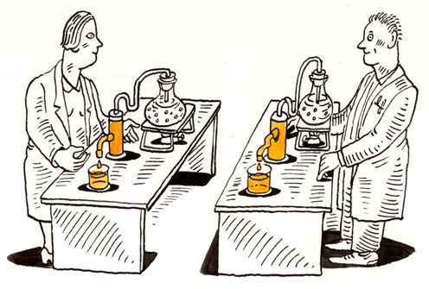
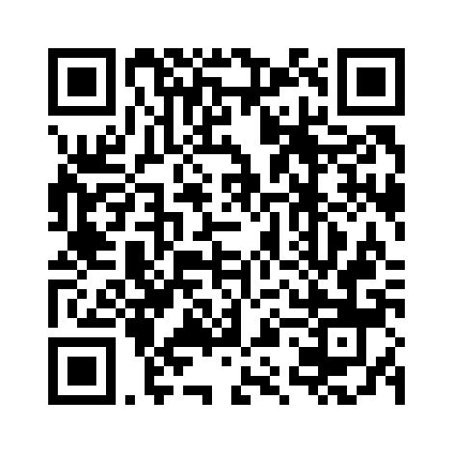
Introduction to Reproducible Science w/ Python
Nelson Roque, PhD
Assistant Professor, Penn State University
Scan for
Slides & Code available on GitHub
Notes:
Image: https://www.displayr.com/what-is-reproducible-research/
QR code needs replaced

Slide 2
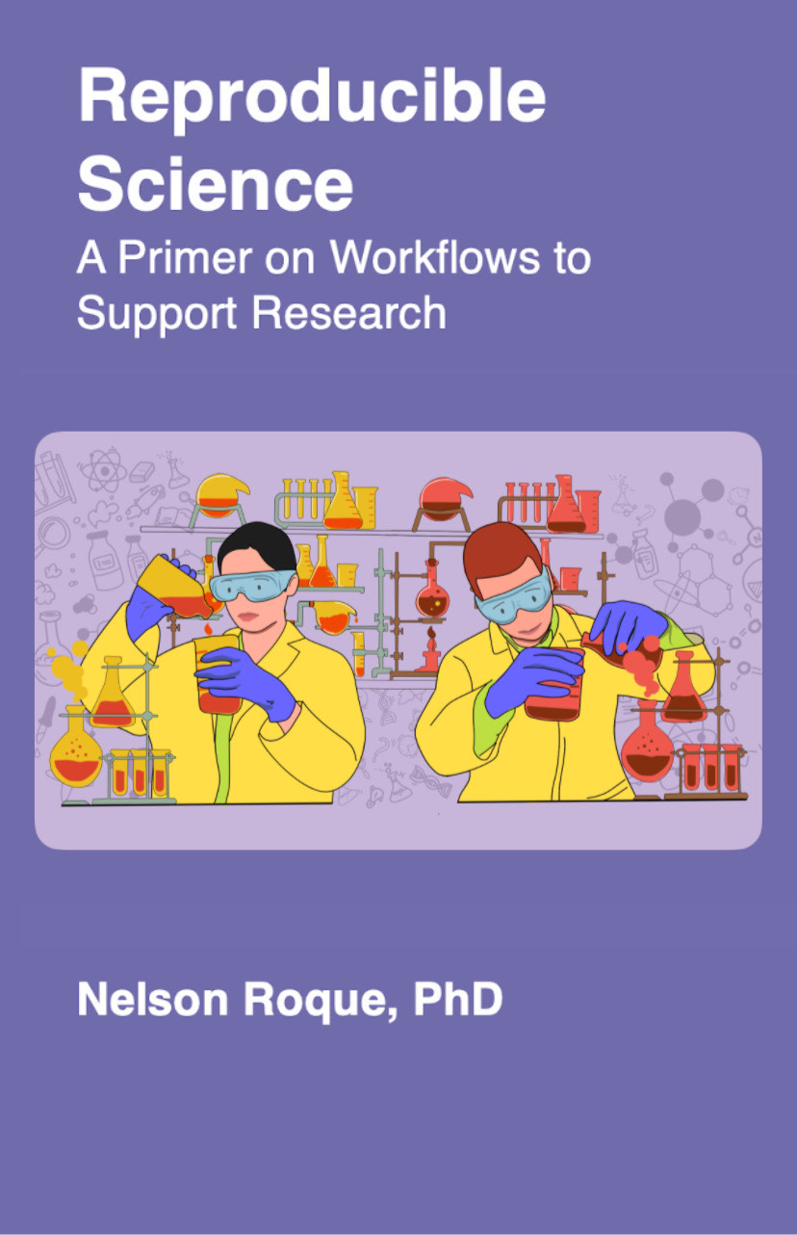
Background
Over the last decade I've engaged in professional development and research opportunities to become proficient across topics including data wrangling and modeling of text, image, video, and eye-tracking data, as well as more recently, sensor data.
I look forward to training the next generation of scientists on code-based methods to enhance reproducibility and usability of their research results.

Slide 3

Workshop Materials & Required Software
All slides, code, and recordings will be made available at the website listed below, as well as Github
Code & Slides
https://github.com/nelsonroque/contextlab_reproduciblescience_workshops
Textbook
https://nelsonroque.github.io/contextlab_introdatascience_webcourse/
Cloud-based Python environment
Provides free GPU and TPU resources
Jupyter Notebook integration
Real-time collaboration
Accessible from any device
Integrated with Google Drive
Supports rich text and media
Pre-installed popular libraries
Ideal for data science and ML

Slide 4
Workshop Learning Objectives
Describe various principles, tools and techniques supportive of open and reproducible science.
Develop a code-only pipeline to allow reproducibility of data preparation and analyses.
Learn about data wrangling principles (e.g., tidy data)
Import, pre-process & visualize data using Python
Develop a long-term learning plan for practicing reproducible science tools and techniques.
Share recommended readings, activities for continued learning

Slide 5
Agenda for Today
What is Reproducible Science? Why?
Tools Supporting Reproducible Science
What is Data Science?
Workflows Supporting Reproducible Data Science Science
Orientation to Python, Jupyter Notebooks, Google Colab
Skill 1: Python syntax primer
Skill 2: Data wrangling and visualization
Data Science: Latest trends
Long-term Learning Recommendations
Notes:
How version control works
Show diagrams of branches and merges, pull requests

Slide 6
What is Reproducible Science?

Slide 7
Reproducible versus replicable
Reproducible: when the exact results can be reproduced if given access to the original data, software, or code
Replicable: research results can be reproduced by independent researchers using different methods.

Slide 8
What is reproducible science?
Making entire scientific process transparent (as allowable; often required by law, grants).
Sharing experiment, raw data, and analysis code
Detailed methods (e.g., STROBE checklist)
Sharing stimulus sets
Being able to walk through a data analysis start (load raw data) to finish (manuscript analyses) in code
Following FAIR Principles
Pre-registering hypotheses and analysis plans (e.g., on OSF)
Notes:
More on this: https://www.displayr.com/what-is-reproducible-research/

Slide 9
Why Reproducible Science?

Slide 10
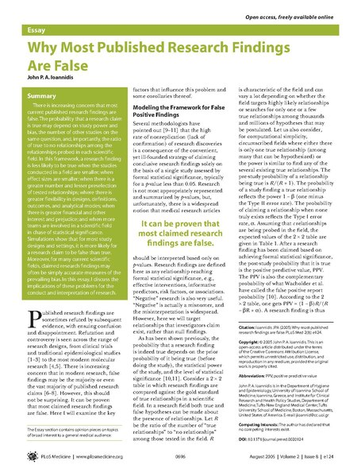
Background
A reproducibility crisis has emerged as a threat to the scientific enterprise.
Ioannidis, John P A. 2005. “Why Most Published Research Findings Are False.” PLoS Medicine 2 (8): e124. doi:10.1371/journal.pmed.0020124.
Munafò, M. R., Nosek, B. A., Bishop, D. V., Button, K. S., Chambers, C. D., Percie du Sert, N., ... & Ioannidis, J. (2017). A manifesto for reproducible science. Nature human behaviour, 1(1), 1-9.
Open Science Collaboration. 2015. “Estimating the Reproducibility of Psychological Science.” Science 349 (6251): aac4716–aac4716. doi:10.1126/science.aac4716.

Slide 11
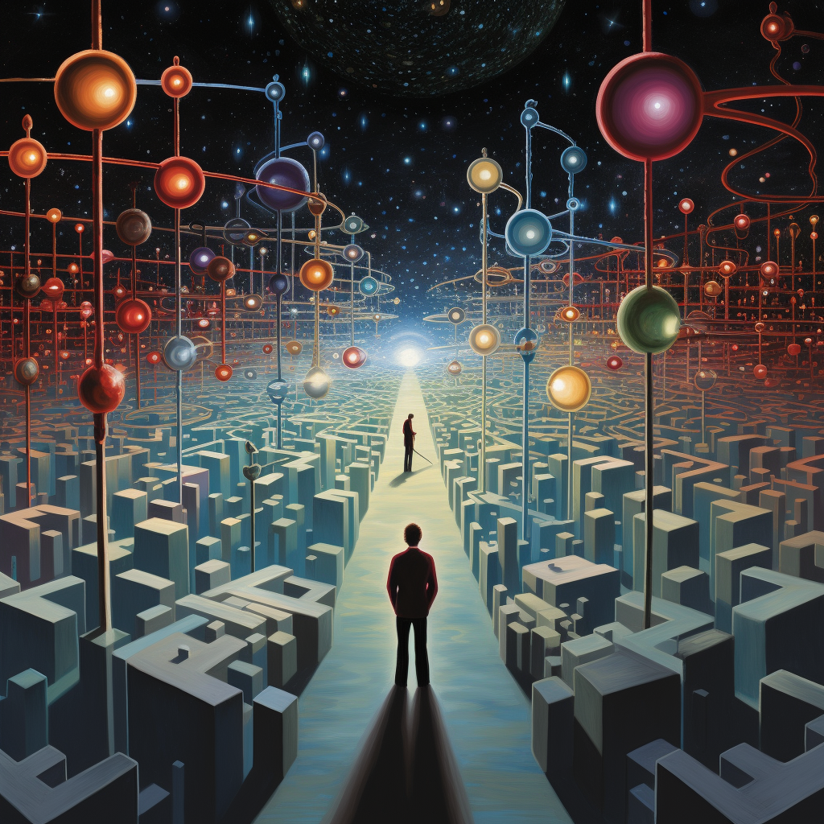
Experimenter Degrees of Freedom
Choices researchers have in experiment design, data analysis, and reporting
Researchers choose variables, sample sizes, and conditions.
Researchers select statistical tests and criteria for significance.
Can lead to variability in research approaches and results

Slide 12
Benefits of reproducible research
increased likelihood that the research will be correct
reproducibility makes it easier to check the research
it is easier to reproduce the research independently
easier to extend the research
reusable code and instruction resulting in increased efficiencies
https://www.displayr.com/what-is-reproducible-research

Slide 13
Tools Supporting
Reproducible Science

Slide 14
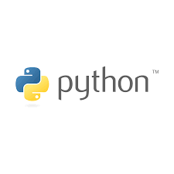








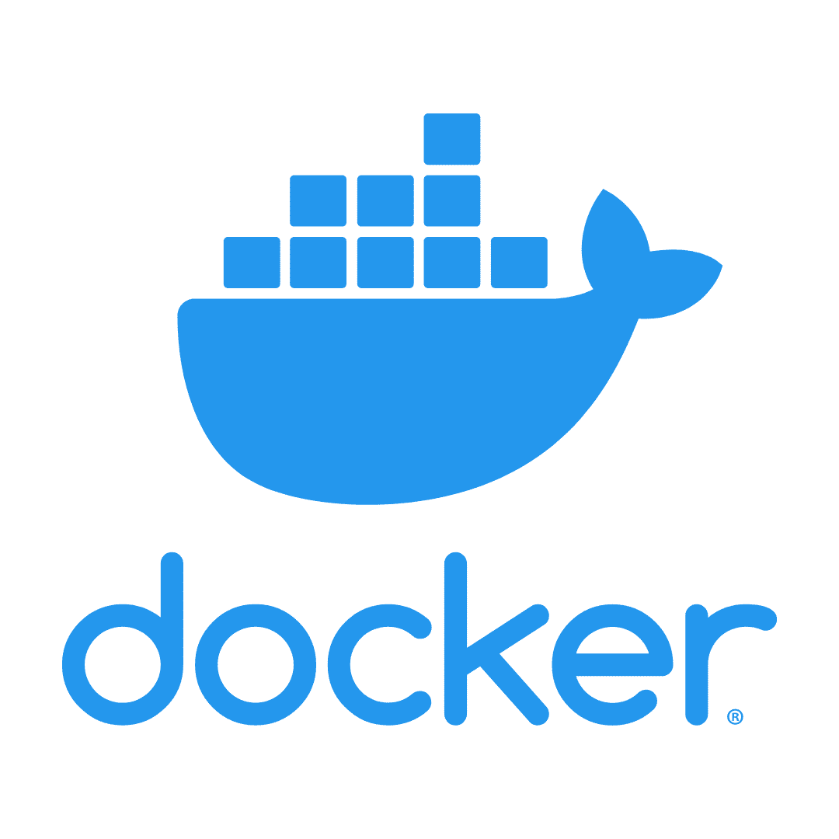

Tools Supporting Reproducible Science
R
Latex, Markdown
Python, Anaconda
Github, Github Pages: https://pages.github.com
Docker, VMs
Infrastructure as Code (IaC; e.g., AWS CDK)
IDEs (e.g., Visual Studio Code)
Open Science Framework
Documentation software: Docusaurus, https://docusaurus.io
Code-based experiment creation software: Opensesame, Psychopy, jsPsych

Slide 15
What is Data Science?

Slide 16
What is data science?
Data science is all about collecting, analyzing, and using data to solve mysteries, make predictions, and help the world work better.

Slide 17
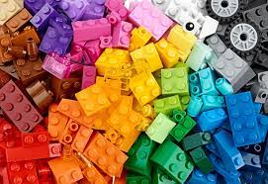
In a perfect data-generating system, data are already tidy.

Slide 18
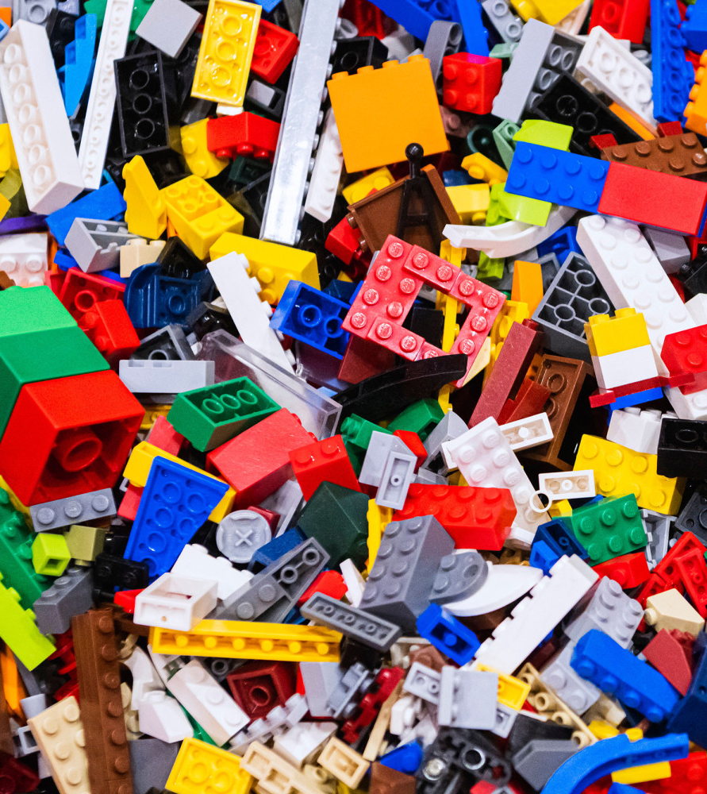
Uncleaned Data Problems
In practice, we must first determine data structure issues:
Column headers are values, not variable names.
Multiple variables are stored in one column.
Variables are stored in both rows and columns.
Multiple types of observational units are stored in the same table.
A single observational unit is stored in multiple tables.
Data quality issues
Values out of range
Improperly/inconsistently coded response options
Inconsistent records counts

Slide 19
Workflows Supporting
Reproducible Data Science

Slide 20
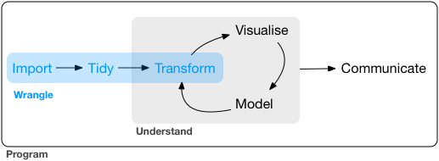
What is a typical data science workflow?
Data collection
The operations that carry your data from raw form, into something visualizable or analyzable
i.e., the data preparation phase of the research
Source: R for Data Science
Notes:
https://vita.had.co.nz/papers/tidy-data.pdf

Slide 21
What is tidy data?
Every column is a variable.
Every row is an observation.
Every cell is a single value.
participant | condition | avg_response_time | perc_accuracy
9991 | control | 506 | 90
9992 | active | 516 | 96
9993 | control | 526 | 99
Source: R for Data Science
Notes:
https://vita.had.co.nz/papers/tidy-data.pdf

Slide 22
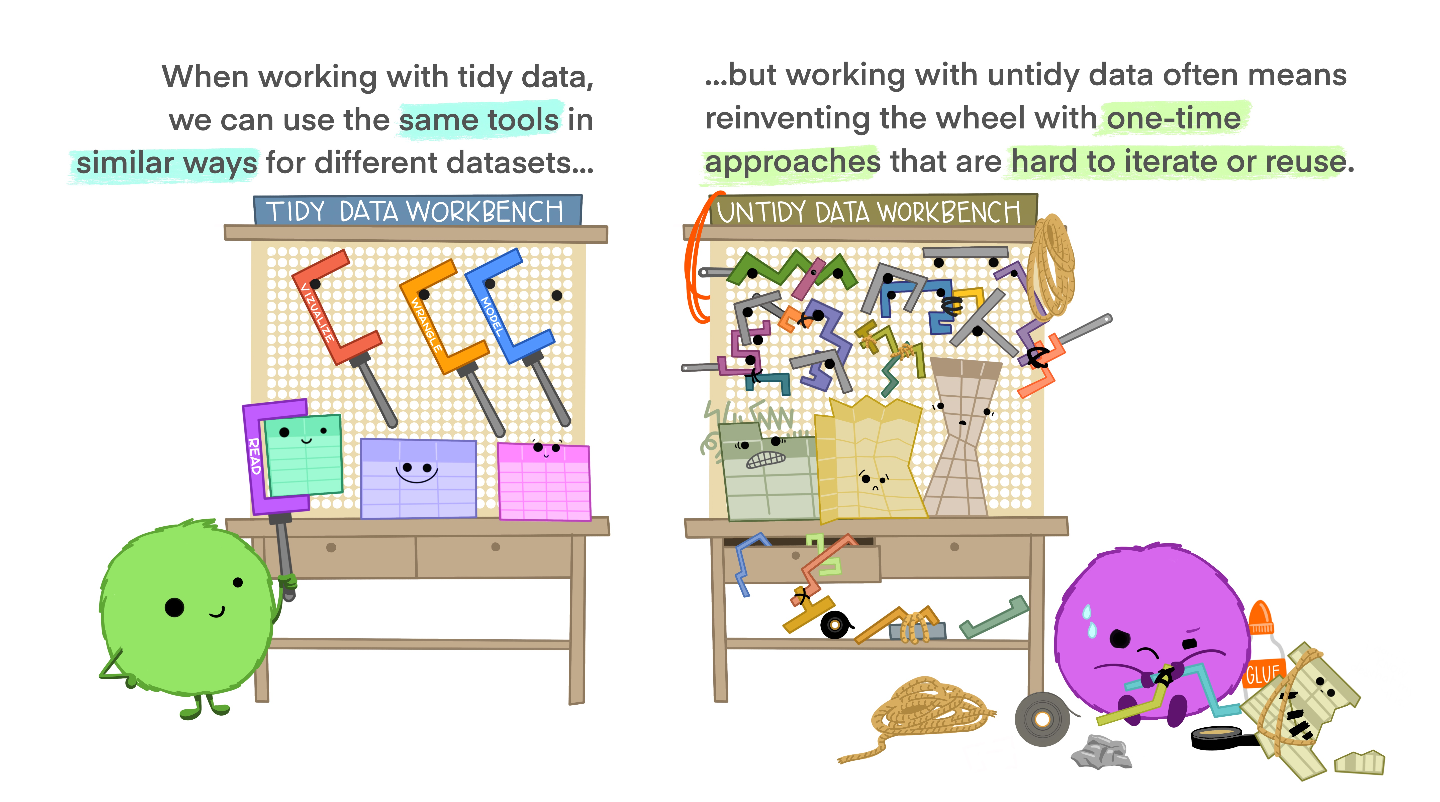
Notes:
Illustrations from the Openscapes blog Tidy Data for reproducibility, efficiency, and collaboration by Julia Lowndes and Allison Horst

Slide 23
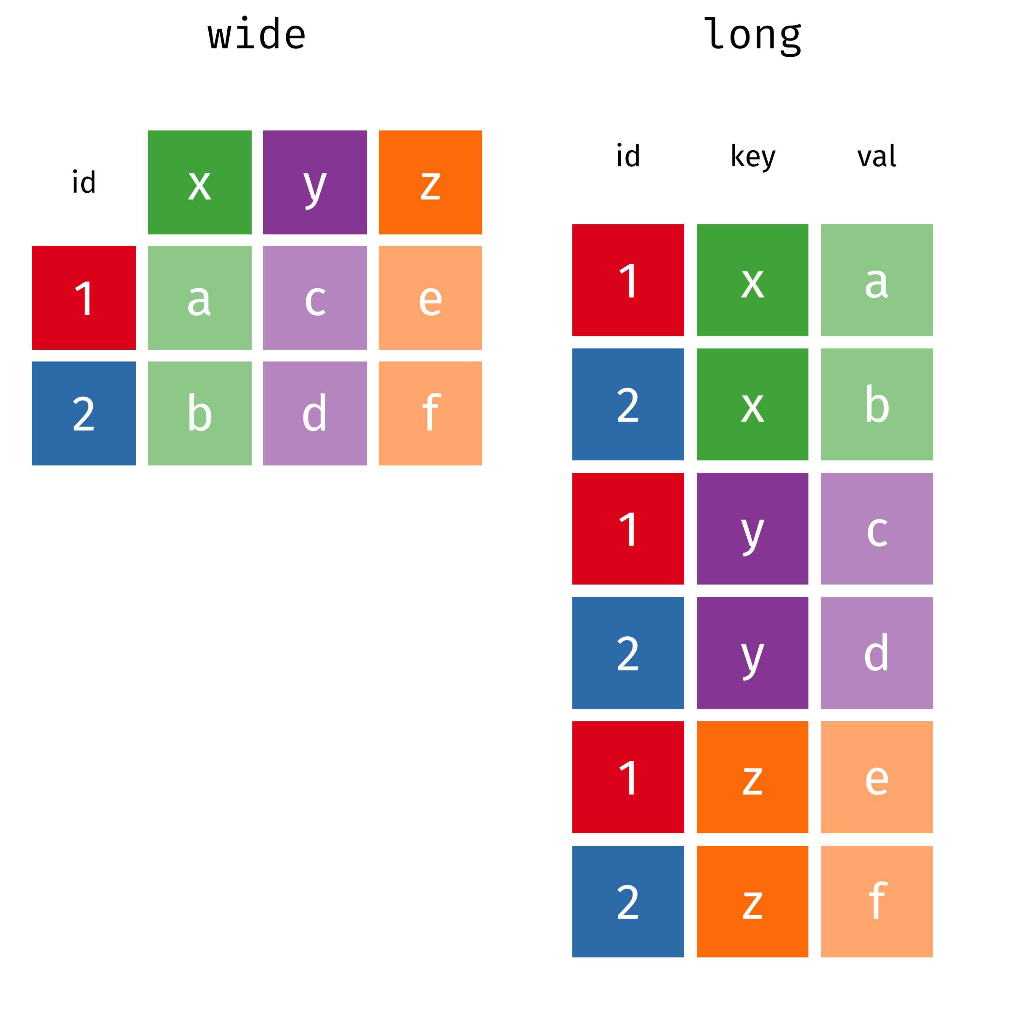
Data wrangling operations
Data exploration
Plotting, descriptive stats
Dealing with missing data
Impute missing data, insert missing codes (-999)
Reshaping data
Add columns (e.g., create flag is missing more than 10 records)
Update column names (id = participant_id)
Converting between long and wide format
Notes:
Graphics from: https://www.garrickadenbuie.com/project/tidyexplain/#usage
https://github.com/gadenbuie/tidyexplain

Slide 24
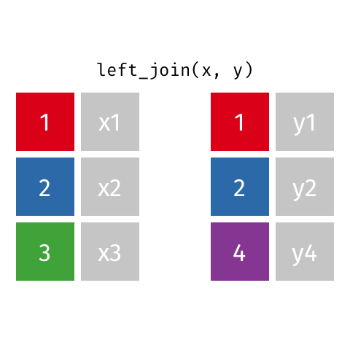
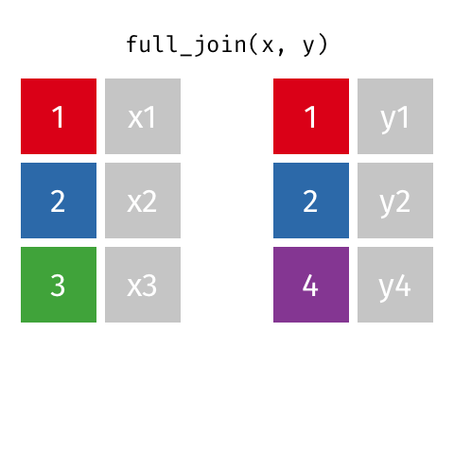
Data wrangling operations
Filtering data
Remove specific observations, by column or row
Merging/matching data from various sources
Join data by common id(s) in various ways (more on next slides)
https://dplyr.tidyverse.org/articles/two-table.html
Other wrangling
Feature engineering
E.g., Add ‘features’ of date as new columns (e.g., what is day of week for 10/13/2020)

Slide 25
Orientation to Python, Jupyter Notebooks, Google Colab
Interactive Live Coding Segment Begins In 6 Slides!

Slide 26
What is Python? Jupyter Notebooks?
What is Python?
Python: High-level programming language
Versatile: Popular for data analysis, web development, machine learning and AI
Easy to learn
What is Jupyter Notebooks?
Interactive documents: Combines code, text, and visualizations
Ideal for data exploration and analysis
Supports multiple programming languages
Popular among data scientists and researchers

Slide 27
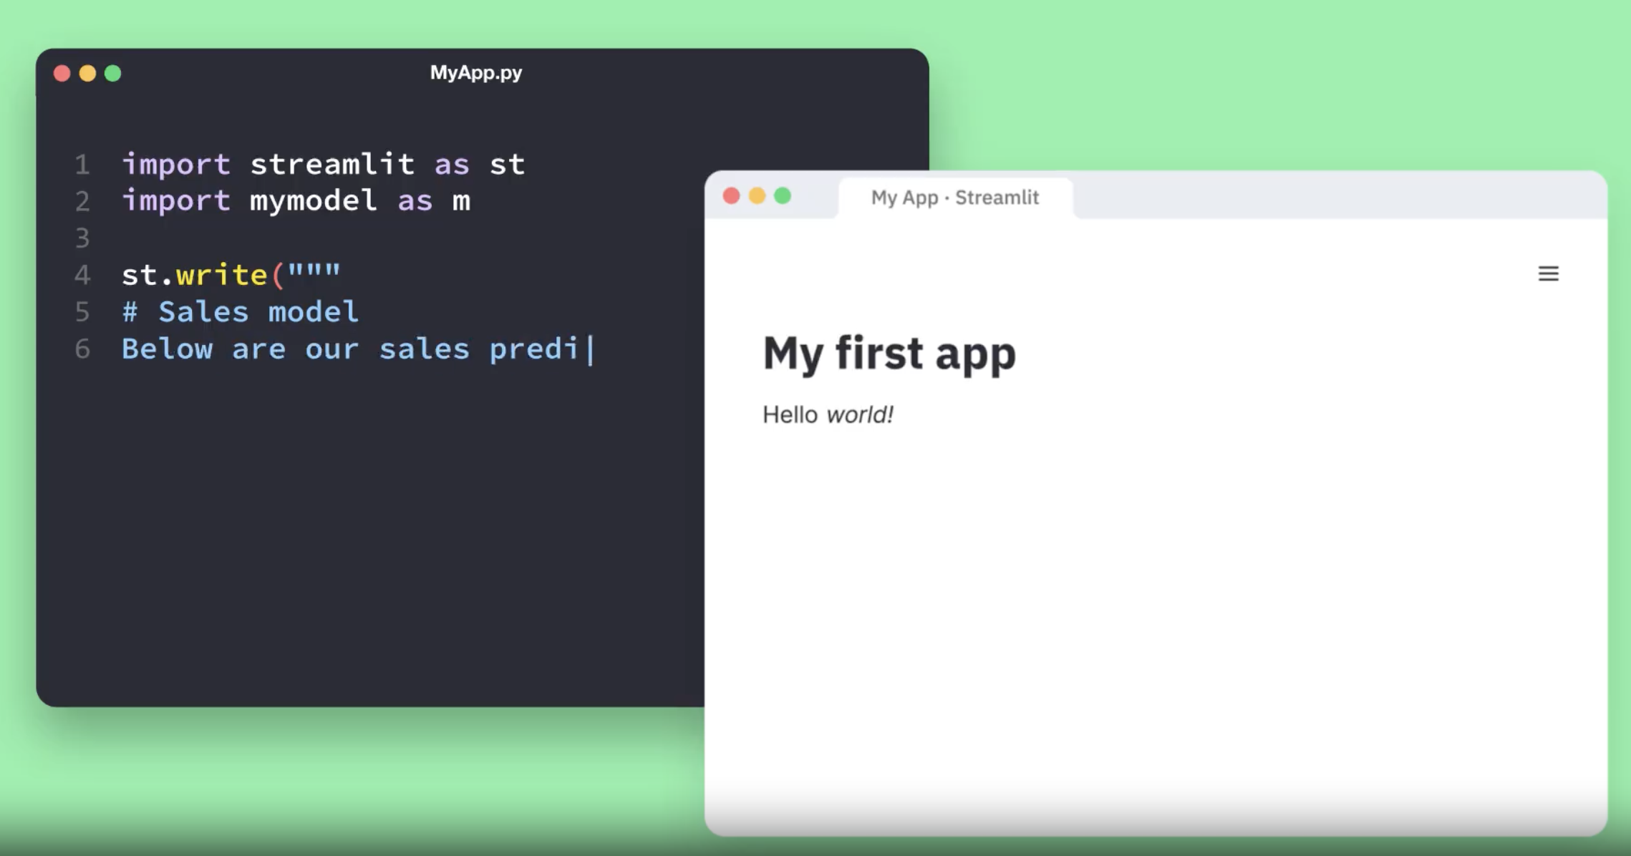
What can you build with Python?
Websites
Mobile and desktop apps
Machine learning models
Bots: Chat Bot, Discord Bot
Dashboards
Data science
An example of Getting Started with Streamlit, a popular Python library for writing dashboards and other web apps: https://streamlit.io/

Slide 28


What are Python libraries?
Libraries of code to accomplish specific functions
e.g., data viz, machine learning, data wrangling, compute effect sizes
Think of `pip` as an equivalent to iOS App Store, or Google Play Store
CRAN is where you download published R packages (directly from R, RStudio)
pip is where you download published Python packages

Slide 29
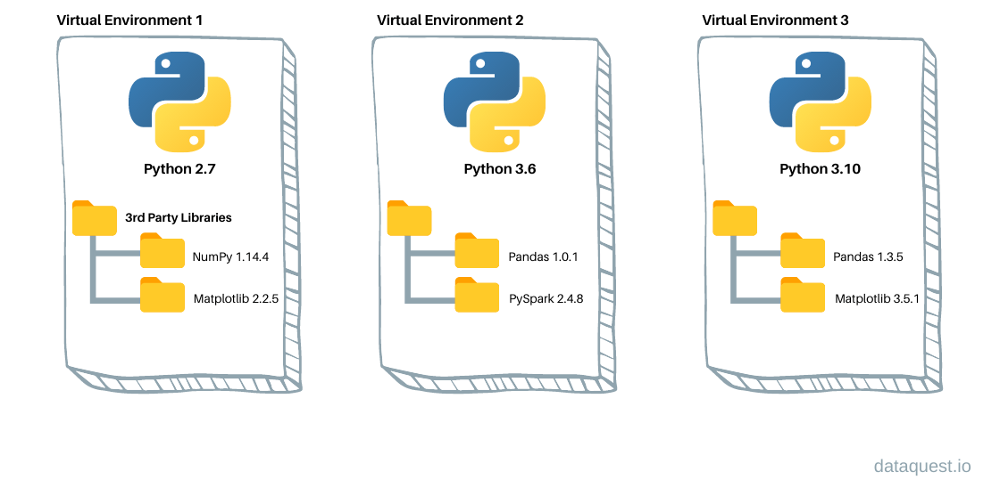
What are Virtual Environments?
A tool to segment the libraries needed for a project, away from libraries needed for another project
e.g., library A version 1.0 may be needed for Project A, but library A version 2.0 may be needed for Project B
Notes:
Python virtual environments are like having separate playgrounds for different activities. Imagine you have a big field, and you want to play soccer in one corner and build a sandcastle in another corner. But there's a problem: the soccer ball might mess up your sandcastle!
So, you create two special areas with invisible walls. In one area, you have a soccer ball, goals, and players, and in the other area, you have sand, buckets, and shovels. Now, you can play soccer without worrying about your sandcastle getting ruined, and you can build your sandcastle without the soccer ball kicking sand everywhere.
In the computer world, Python virtual environments do something similar. They create separate spaces for different Python projects. Each space has its own set of Python tools and toys (libraries and packages). This way, you can work on one project without it affecting another. It's like having organized, separate sandboxes for your coding projects, so they don't mix up and cause problems. That's why Python virtual environments are important—they keep your projects tidy and working correctly.

Slide 30
Basic data types & structures
Integers (int): Whole numbers (e.g., -3, 0, 42).
Floating-Point Numbers (float): Numbers with decimal points (e.g., 3.14, -0.001).
Strings (str): Text enclosed in quotes (e.g., "Hello, World!", 'Python').
Booleans (bool): Represents True or False.
Lists (list): Ordered collections of items (e.g., [1, 2, 3]).
Tuples (tuple): Immutable ordered collections (e.g., (1, 2, 3)).
Dictionaries (dict): Key-value pairs (e.g., {"name": "John", "age": 30}).
Sets (set): Unique, unordered collections (e.g., {1, 2, 3}).
NoneType (None): Represents the absence of a value.
Notes:
https://www.programiz.com/r/data-types

Slide 31
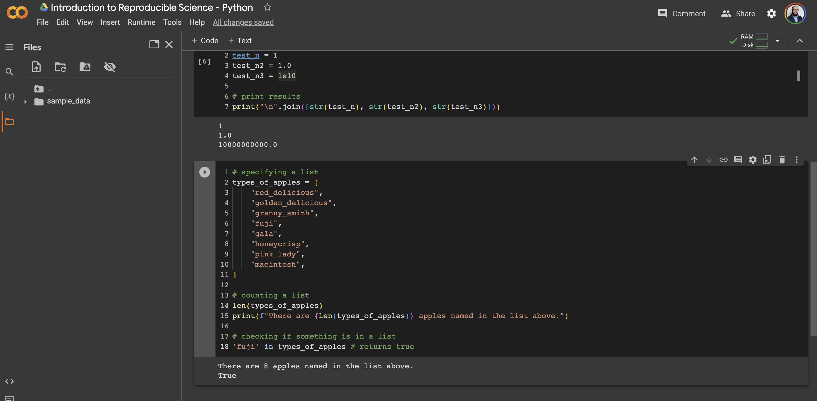
Files
Anatomy of Google Collab
Usage
Cell with output
Cell settings

Slide 32
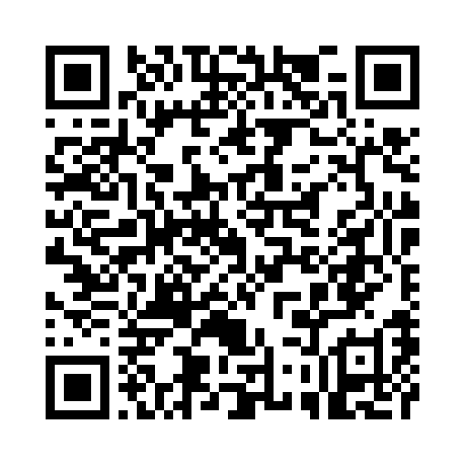
Let’s jump into Python
Scan the QR code to view the code we will work with

Slide 33
Data Science: Latest Trends

Slide 34
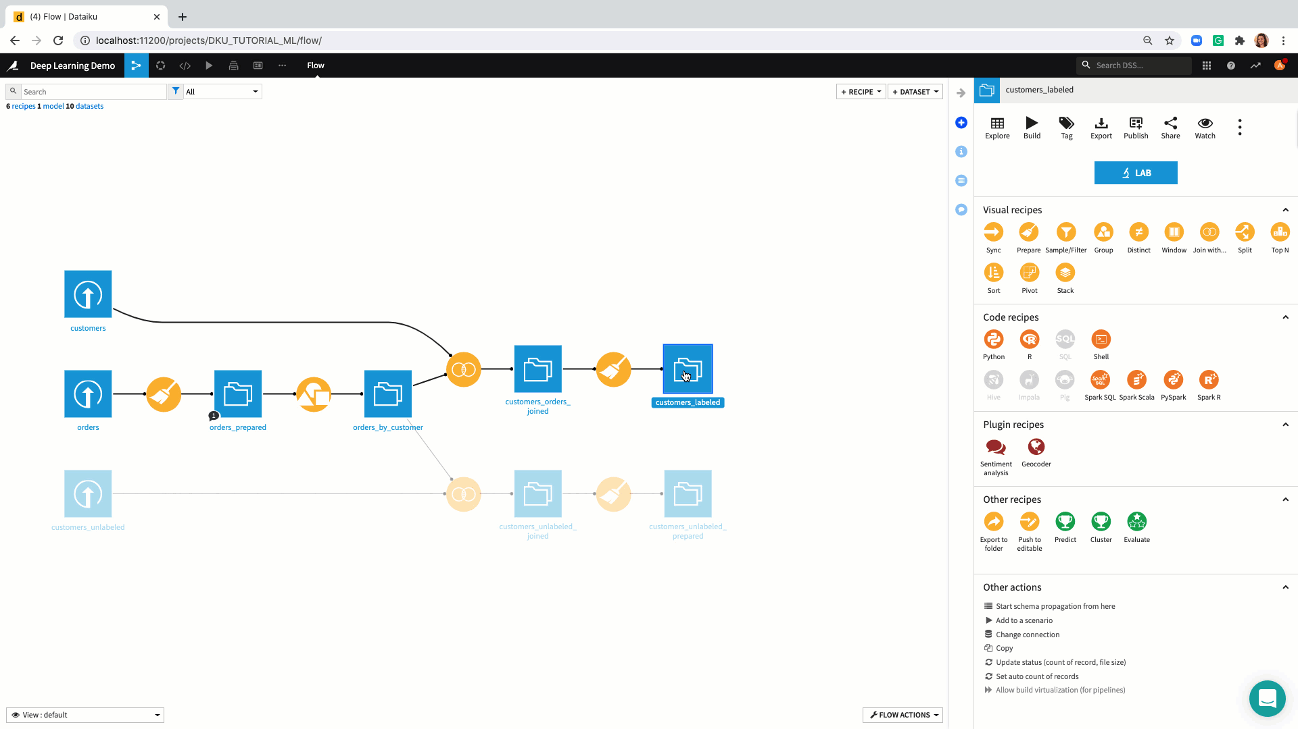

The Future of Data Workflows: No/Low Code
Seamless integration platforms, for example:

Slide 35
Long-term learning

Slide 36
Developing your Learning Plan
Subscribe to Python, ML blogs (e.g., Towards Data Science)
Create a personal library for ongoing reference
Attend webinars, seminars, and conferences
Pursue certifications (e.g., Coursera, Udacity) for validation
Join local meetups and networking events
Seek mentorship and mentor others
Regularly read research papers and tech news (tldr).
PRACTICE WITH REAL DATA

Slide 37
PRACTICE WITH REAL DATA
https://www.kaggle.com/datasets
https://www.data.gov/

Slide 38


You are not alone
ChatGPT

Slide 39
Download Python Cheatsheets
Tutorials
https://github.com/mGalarnyk/Python_Tutorials
https://www.geeksforgeeks.org/data-science-tutorial/
https://www.w3schools.com/datascience/ds_python.asp
Books
https://jakevdp.github.io/PythonDataScienceHandbook/
https://www.knowledgehut.com/blog/data-science/python-data-science-books
https://wesmckinney.com/book/

Slide 40



THANK YOU
nur375@psu.edu nelsonroque.com https://github.com/nelsonroque

